Slide 1


Problem Solving

Slide 2
Objectives
Student should be familiar with the following algorithms, and should be able to code the algorithms
BFS
DFS
Uniform Cost Search
Iterative Deepening Search
Bidirectional Search
A*
AO*
The students should understand the state space representation, and familiarity with some common problems formulated as state space search problems.

Slide 3
Continue…
Given a problem description, the student should be able to formulate it in terms of a state space search problem.
The student should understand how implicit state spaces can be unfolded during search.
Understand how states can be represented by features.

Slide 4
Index
Introduction
Problem Solving Agent
Formulating Problems
Example Problems
Types of Problems
Searching For Solutions
Measuring problem solving performance
Uninformed search
BFS
Uniform-cost search
DFS
Depth Limited Search
Iterative deepening search
Bidirectional search
Informed search
Greedy best-first search
A∗ search
AO*
References

Slide 5

Introduction
In which we see how an agent can find a sequence of actions that achieves its goals, when no single action will do.
The method of solving problem through AI involves the process of defining the search space, deciding start and goal states and then finding the path from start state to goal state through search space.
State space search is a process used in the field of computer science, including artificial intelligence(AI), in which successive configurations or states of an instance are considered, with the goal of finding a goal state with a desired property.

Slide 6
Continue…
This is a one kind of goal-based agent called a problem-solving agent.
Problem-solving agents use atomic representations, states of the world are considered as wholes, with no internal structure visible to the problem solving algorithms.

Slide 7

Continue…
Goal-based agents that use more advanced factored or structured representations are usually called planning agents.
Problem solving begins with precise definitions of problems and their solutions and give several examples to illustrate these definitions.
We then describe several general-purpose search algorithms that can be used to solve these problems. We will see several uninformed search algorithms— algorithms that are given no information about the problem other than its definition.
Although some of these algorithms can solve any solvable problem, none of them can do so efficiently.
Informed search algorithms, on the other hand, can do quite well given some guidance on where to look for solutions.

Slide 8


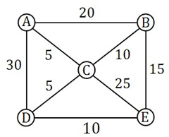
Problem Solving Agents
Intelligent agents are supposed to maximize their
performance measure.
Problem-solving agents: find sequence of actions that achieve goals.
In this section we will use a map as an example, if you take fast look you can deduce that each node represents a city, and the cost to travel from a city to another is denoted by the number over the edge connecting the nodes of those 2 cities.
In order for an agent to solve a problem it should pass by 2 phases of formulation:

Slide 9

Continue..
Goal Formulation:
Problem solving is about having a goal we want to reach, (e.i: I want to travel from ‘A’ to ‘E’).
Goals have the advantage of limiting the objectives the agent is trying to achieve.
We can say that goal is a set of environment states in which our goal is satisfied.
Problem Formulation:
A problem formulation is about deciding what actions and states to consider, we will come to this point it shortly.
We will describe our states as “in(CITYNAME)”
where CITYNAME is the name of the city in which we are currently in.

Slide 10

Continue…
Once our agent has found the sequence of cities it should pass by to reach its goal it should start following this sequence.
The process of finding such sequence is called search, a search algorithm is like a black box which takes problem as input returns a solution, and once the solution is found the sequence of actions it recommends is carried out and this is what is called the execution phase.
We now have a simple (formulate, search, execute) design for our problem solving agent, so lets find out precisely how to formulate a problem.

Slide 11

Formulating Problems
A problem can be defined formally by 4 components:
Initial State:
– it is the state from which our agents start solving the problem {e.i: in(A)}.
State Description:
a description of the possible actions available to the agent, it is common to describe it by means of a successor function, given state x then SUCCESSOR-FN(x) returns a set of ordered pairs
<action, successor> where action is a legal action from state x and successor is the state in
which we can be by applying action.
The initial state and the successor function together defined what is called state space which is the set of all possible states reachable from the initial state {e.i: in(A), in(B), in(C), in(D), in(E)}.

Slide 12





Continue..
Goal Test:
– we should be able to decide whether the current state is a goal state {e.i: is the current state is in(E)?}.
Path cost:
– a function that assigns a numeric value to each path, each step we take in solving the problem should be somehow weighted, so If I travel from A to E our agent will pass by many cities, the cost to travel between two consecutive cities should have some cost measure, {e.i: Traveling from ‘A’ to ‘B’ costs 20 km or it can be typed as c(A, 20, B)}.
A solution to a problem is path from the initial state to a goal state, and solution quality is measured by the path cost, and the optimal solution has the lowest path cost among all possible solutions.

Slide 13
EXAMPLE PROBLEMS
Toy Problem

Slide 14
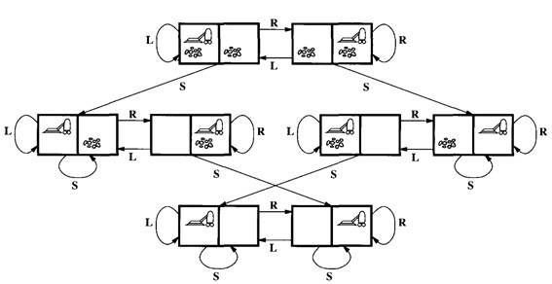

Slide 15

Vacuum World
– Initial state:
Our vacuum can be in any state of the 8 states shown in the picture.
– State description:
Successor function generates legal states resulting from applying the three actions {Left, Right, and Suck}.
The states space is shown in the picture, there are 8 world states.
– Goal test:
Checks whether all squares are clean.
– Path cost:
Each step costs 1, so the path cost is the sum of steps in the path.
Problem Solving Agen
mar Jukuntla
15

Slide 16
EXAMPLE PROBLEMS
8 Puzzle

Slide 17
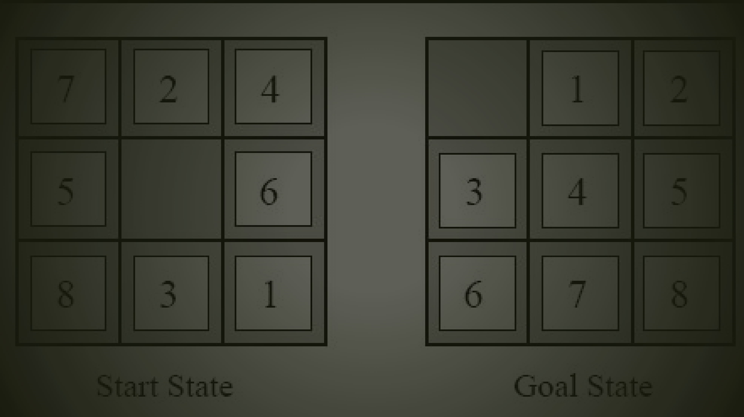
8-Puzzle
Initial state:
– Our board can be in any state resulting from making it in any configuration.
State description:
Successor function generates legal states resulting from applying the three actions {move blank Up, Down, Left, or Right}.
State description specifies the location of each of the eight titles and the blank.
Goal test:
– Checks whether the states matches the goal configured in the goal state shown in the picture.
Path cost:
– Each step costs 1, so the path cost is the sum of steps in the path.

Slide 18
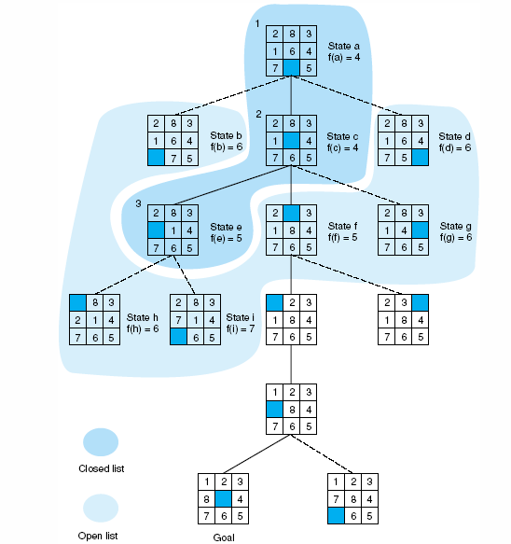

Slide 19
EXAMPLE PROBLEMS
8-Queens Problem

Slide 20
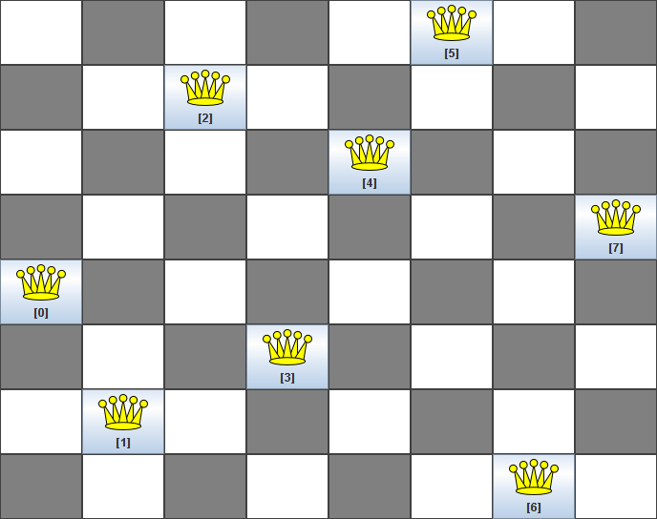



8-Queens Problem
States: ???
Initial State: ???
Successor Function: ???
Goal Test: ???

Slide 21
EXAMPLE PROBLEMS
Real World Problem

Slide 22

Real World Problems
Airline Travelling Problem
States:
– Each is represented by a location and the current time.
Initial State:
– This is specified by the problem.
Successor Function:
– This returns the states resulting from taking any scheduled flight, leaving later than the current time plus the within airport transit time, from the current airport to another.
Goal Test:
– Are we at the destination by some pre-specified time?
Path Cost:
– This depends on the monetary cost, waiting time, flight time, customs and immigration procedures, seat quality, time of day, type of air place, frequent-flyer mileage awards and so on.

Slide 23
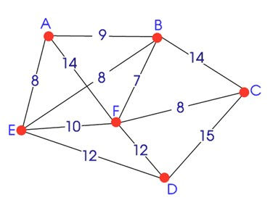
Continue…
Touring problems
Traveling salesperson problem
Robot navigation
Automatic assembly sequencing

Slide 24

SEARCHING FOR SOLUTIONS
After formulating our problem we are ready to solve it, this can be done by searching through the state space for a solution, this search will be applied on a search tree or generally a graph that is generated using the initial state and the successor function.
Searching is applied to a search tree which is generated through state expansion, that is applying the successor function to the current state, note that here we mean by state a node in the search tree.
Generally, search is about selecting an option and putting the others aside for later in case the first option does not lead to a solution, The choice of which option to expand first is determined by the search strategy used.

Slide 25
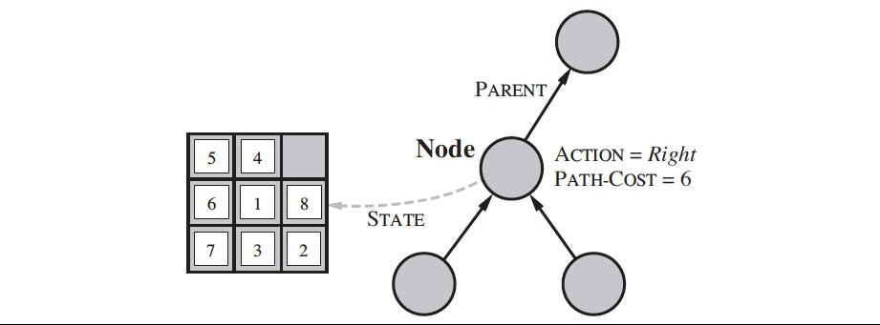

Slide 26
Continue…
The structure of a node in the search tree can be as follows:
State: the state in the state space to which this state corresponds
Parent-Node: the node in the search graph that generated this node.
Action: the action that was applied to the parent to generate this node.
Path-Cost: the cost of the path from the initial state to this node.
Depth: the number of steps along the path from the initial state.
It is important to make a distinction between nodes and states, A node in the search tree is a data structure holds a certain state and some info used to represent the search tree, where state corresponds to a world configuration, that is more than one node can hold the same state, this can happened if 2 different paths lead to the same state.

Slide 27
Measuring problem-solving performance
Search as a black box will result in an output that is either failure or a solution, We will evaluate a search algorithm`s performance in four ways:
Completeness: is it guaranteed that our algorithm always finds a solution when there is one ?
Optimality: Does our algorithm always find the optimal solution ?
Time complexity: How much time our search algorithm takes to find a solution ?
Space complexity: How much memory required to run the search algorithm?
Time and Space in complexity analysis are measured with respect to the number of nodes the problem graph has in terms of asymptotic notations.

Slide 28
Continue…
In AI, complexity is expressed by three factors b, d and m:
b the branching factor is the maximum number of successors of any node.
d the depth of the deepest goal.
m the maximum length of any path in the state space.

Slide 29

Problem Solving By Search
Missionaries and Cannibals
Three missionaries and cannibals are on one side of a river, along with a boat that can hold one or two people. Find a way to get everyone to the other side, without ever leaving a group of missionaries outnumbered by cannibals.
How do we transport them other side of the river?

Slide 30
RECAP
30

Slide 31

Recap
Before an agent can start searching for solutions, a goal must be identified and a well defined problem must be formulated.
A problem consists of five parts: the initial state, a set of actions, a transition model describing the results of those actions, a goal test function, and a path cost function.
The environment of the problem is represented by a state space. A path through the state space from the initial state to a goal state is a solution.
Search algorithms are judged on the basis of completeness, optimality, time complexity, and space complexity. Complexity depends on b, the branching factor in the state space, and d, the depth of the shallowest solution.

Slide 32
Problem solving
We want:
To automatically solve a problem
We need:
A representation of the problem
Algorithms that use some strategy to solve the problem defined in that representation

Slide 33
Problem representation
General:
State space: a problem is divided into a set of resolution steps from the initial state to the goal state
Reduction to sub-problems: a problem is arranged into a hierarchy of sub-problems
Specific:
Game resolution
Constraints satisfaction

Slide 34
UNIFORMATION
SEARCH
34

Slide 35
Uninformed Search
An uninformed (a.k.a. blind, brute-force) search algorithm generates the search tree without using any domain specific knowledge.
No additional information about states beyond that provided in the problem definition.
All they can do is generate successors and distinguish a goal state from a non-goal state.
All search strategies are distinguished by the order in which nodes are expanded.
Move systematically between states until we stumble on a goal

Slide 36
BREADTH FIRST SEARCH

Slide 37
Breadth-First Search
Expand shallowest unexpanded node
Implementation:
– A FIFO queue, i.e., new successors go at end

Slide 38
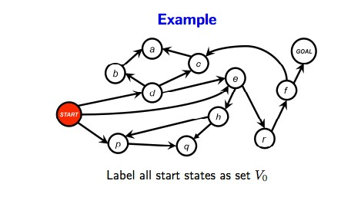

Slide 39
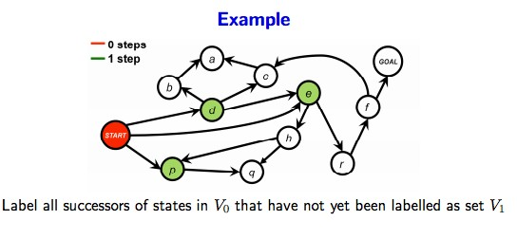

Slide 40
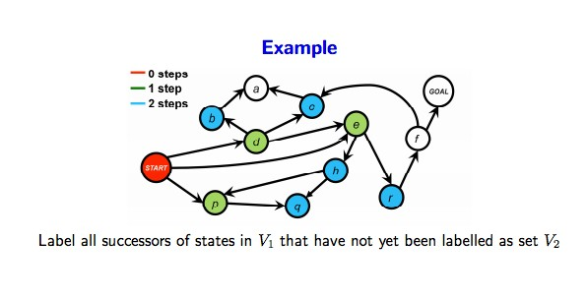

Slide 41
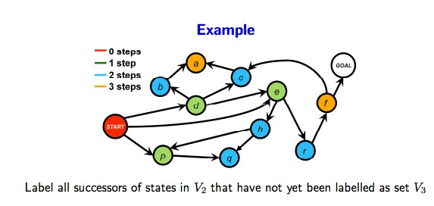

Slide 42
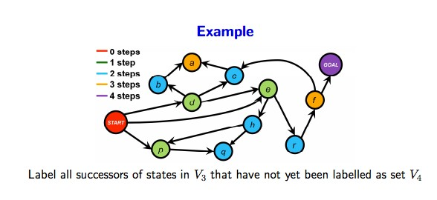

Slide 43
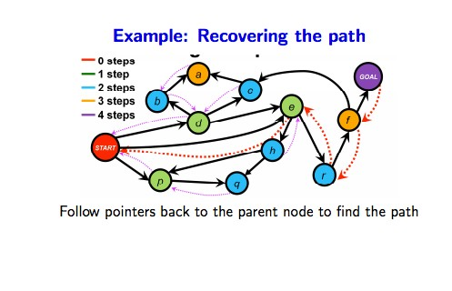

Slide 44
Analyzing BFS
Good news:
Complete
Guaranteed to find the shallowest path to the goal This is not necessarily the best path! But we can “fix” the algorithm to get the best path.
Different start-goal combinations can be explored at the same time
Bad news:
Exponential time complexity: O(bd) (why?) This is the same for all uninformed search methods
Exponential memory requirements! O(bd) (why?) This is not good...

Slide 45
UNIFORM-COST SEARCH

Slide 46
Fixing BFS To Get An Optimal Path
Use a priority queue instead of a simple queue
Insert nodes in the increasing order of the cost of the path so far
Guaranteed to find an optimal solution!
This algorithm is called uniform-cost search

Slide 47
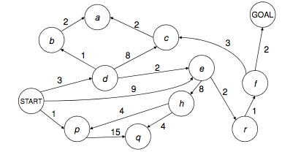
EXAMPLE 1

Slide 48
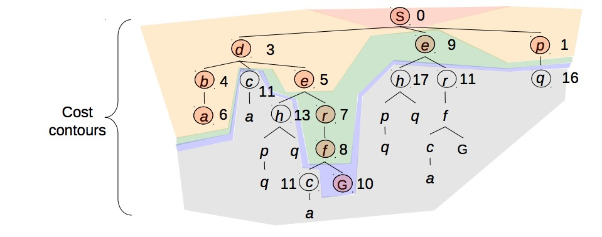

Slide 49
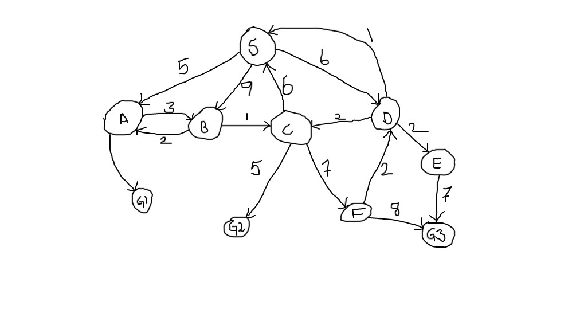
EXAMPLE 2
9

Slide 50
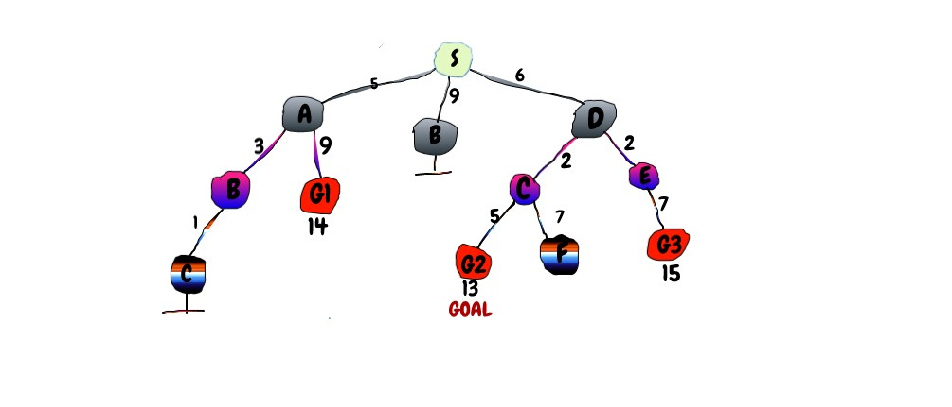

Slide 51
Continue..
Remember: explores increasing cost contours
The good:
– UCS is complete and optimal!
The bad:
Explores options in every “direction”
No information about goal location

Slide 52
DEPTH FIRST SEARCH

Slide 53
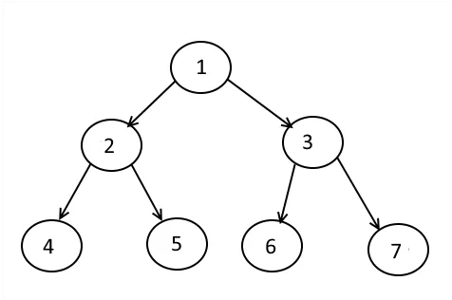
Continue..
In depth-first search, we start with the root node and completely explore the descendants of a node before exploring its siblings (and siblings are explored in a left- to-right fashion).
Depth-first search always expands the deepest node in the current frontier of the search tree.
Depth-first traversal: 1 → 2 → 4 → 5 → 3 → 6 → 7

Slide 54
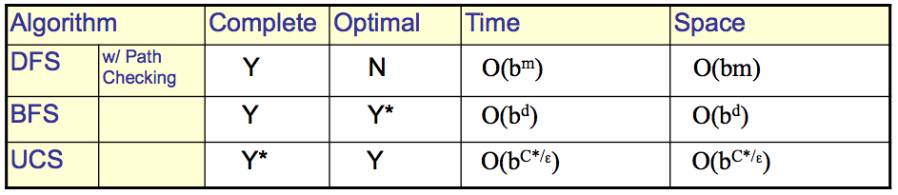
COMPARISON

Slide 55
DEPTH LIMITED SEARCH

Slide 56
CONTINUE…
The embarrassing failure of depth-first search in infinite state spaces can be alleviated by supplying depth-first search with a predetermined depth limit .
That is, nodes at depth are treated as if they have no successors. This approach is called depth-limited search. The depth limit solves the infinite-path problem.
Depth-limited search can be implemented as a simple modification to the general tree or graph-search algorithm.
Notice that depth-limited search can terminate with two kinds of failure: the standard failure value indicates no solution; the cutoff value indicates no solution within the depth limit.

Slide 57
Continue…
Limit = 0
A
Limit = 1
B
C
D
E
Limit = 2
F
G
H
I
J
K
L
M
N
O

Slide 58
Depth-Limited Search (DLS)
A,
A
B
C
D
E
Limit = 2

Slide 59
Depth-Limited Search (DLS)
A,B,
A
B
C
D
E
Limit = 2
F
G

Slide 60
Depth-Limited Search (DLS)
A,B,F,
A
B
C
D
E
Limit = 2
F
G

Slide 61
Depth-Limited Search (DLS)
A,B,F,
G,
A
B
C
D
E
Limit = 2
F
G

Slide 62
Depth-Limited Search (DLS)
A,B,F,
G,
C,
A
B C D
E
Limit = 2
F G H

Slide 63
Depth-Limited Search (DLS)
A,B,F,
G,
C,H,
A
B C D
E
Limit = 2
F G H

Slide 64
Depth-Limited Search (DLS)
A,B,F,
G,
C,H,
D,
A
B
C
D
E
Limit = 2
F
G
H
I
J

Slide 65
Depth-Limited Search (DLS)
A,B,F,
G,
C,H,
D,I
A
B
C
D
E
Limit = 2
F
G
H
I
J

Slide 66
Depth-Limited Search (DLS)
A,B,F,
G,
C,H,
D,I
J,
A
B
C
D
E
Limit = 2
F
G
H
I
J

Slide 67
Depth-Limited Search (DLS)
A,B,F,
G,
C,H,
D,I
J,
E
A
B
C
D
E
Limit = 2
F
G
H
I
J

Slide 68
Depth-Limited Search (DLS)
A,B,F,
G,
C,H,
D,I
J,
E, Failure
A
B
C
D
E
Limit = 2
F
G
H
I
J

Slide 69
Depth-Limited Search (DLS)
DLS algorithm returns Failure (no solution)
The reason is that the goal is beyond the limit (Limit =2): the goal depth is (d=4)
A
B C D E
Limit = 2
F G H I J
K
L
M
N
O

Slide 70
Iterative Deepening Search
It’s a Depth First Search, but it does it one level at a time, gradually increasing the limit, until a goal is found.
Combine the benefits of depth-first and breadth-first search
like DFS, modest memory requirements O(bd)
like BFS, it is complete when branching factor is finite, and optimal when the path cost is a non decreasing function of the dept of the node

Slide 71
Iterative Deepening Search
May seem wasteful because states are generated multiple times
but actually not very costly, because nodes at the bottom level are generated only once
In practice, however, the overhead of these multiple expansions is small, because most of the nodes are towards leaves (bottom) of the search tree:
thus, the nodes that are evaluated several times (towards top of tree) are in relatively small number.
Iterative depending is the preferred uninformed search method when the search space is large and the depth of the solution is unknown

Slide 72
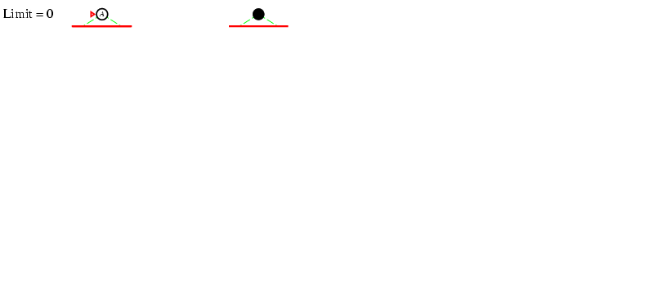
Iterative Deepening Search l =0

Slide 73
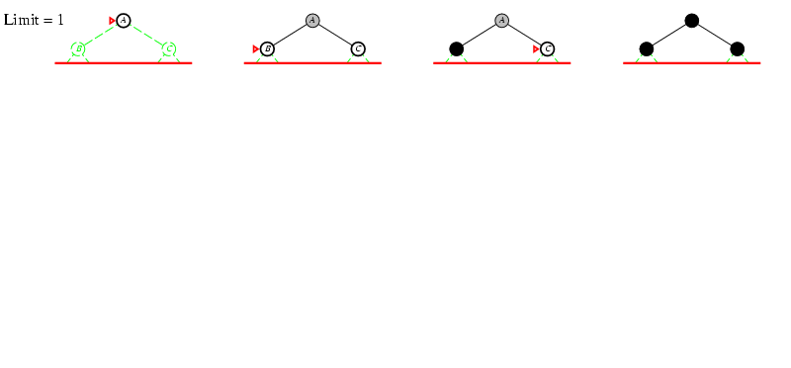
Iterative Deepening Search l =1

Slide 74
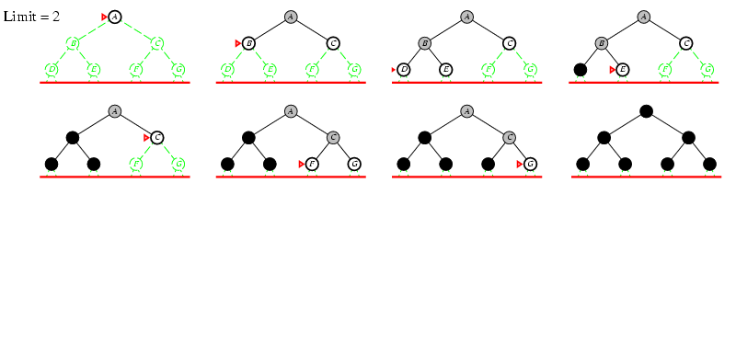
Iterative Deepening Search l =2

Slide 75
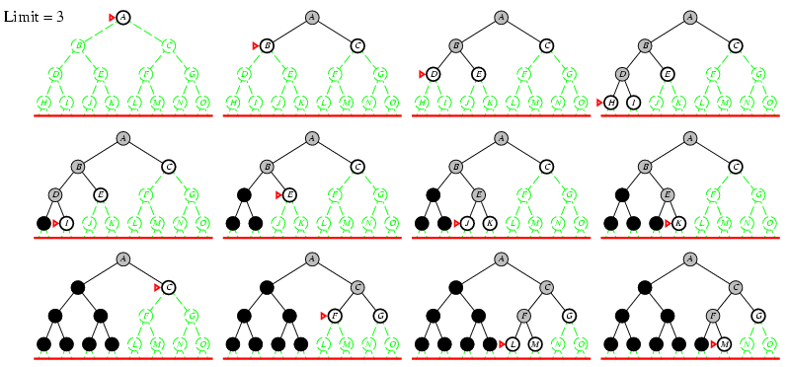
Iterative Deepening Search l =3

Slide 76
Iterative Deepening Search
Combines the best of breadth-first and depth-first search strategies.
Completeness:
Time complexity:
Space complexity:
Optimality:
Yes,
O(b ^{d})
O(bd)
Yes, if step cost = 1

Slide 77
Properties of Iterative Deepening Search
Complete? Yes (b finite)
Time? d b¹ + (d-1)b² + … + b^{d} = O(b^{d})
Space? O(bd)
Optimal? Yes, if step costs identical

Slide 78


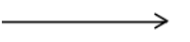
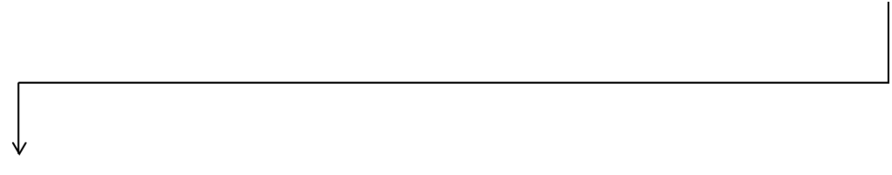
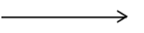


Stop when the two searches meet in the middle.
Both search forward from initial state, and backwards from goal.
Bidirectional Search
Motivation: b^{d/2} + b^{d/2} is much less than b^{d}
Implementation
Start Goal
Replace the goal test with a check to see whether the frontiers of the two searches intersect, if yes
solution is found

Slide 79
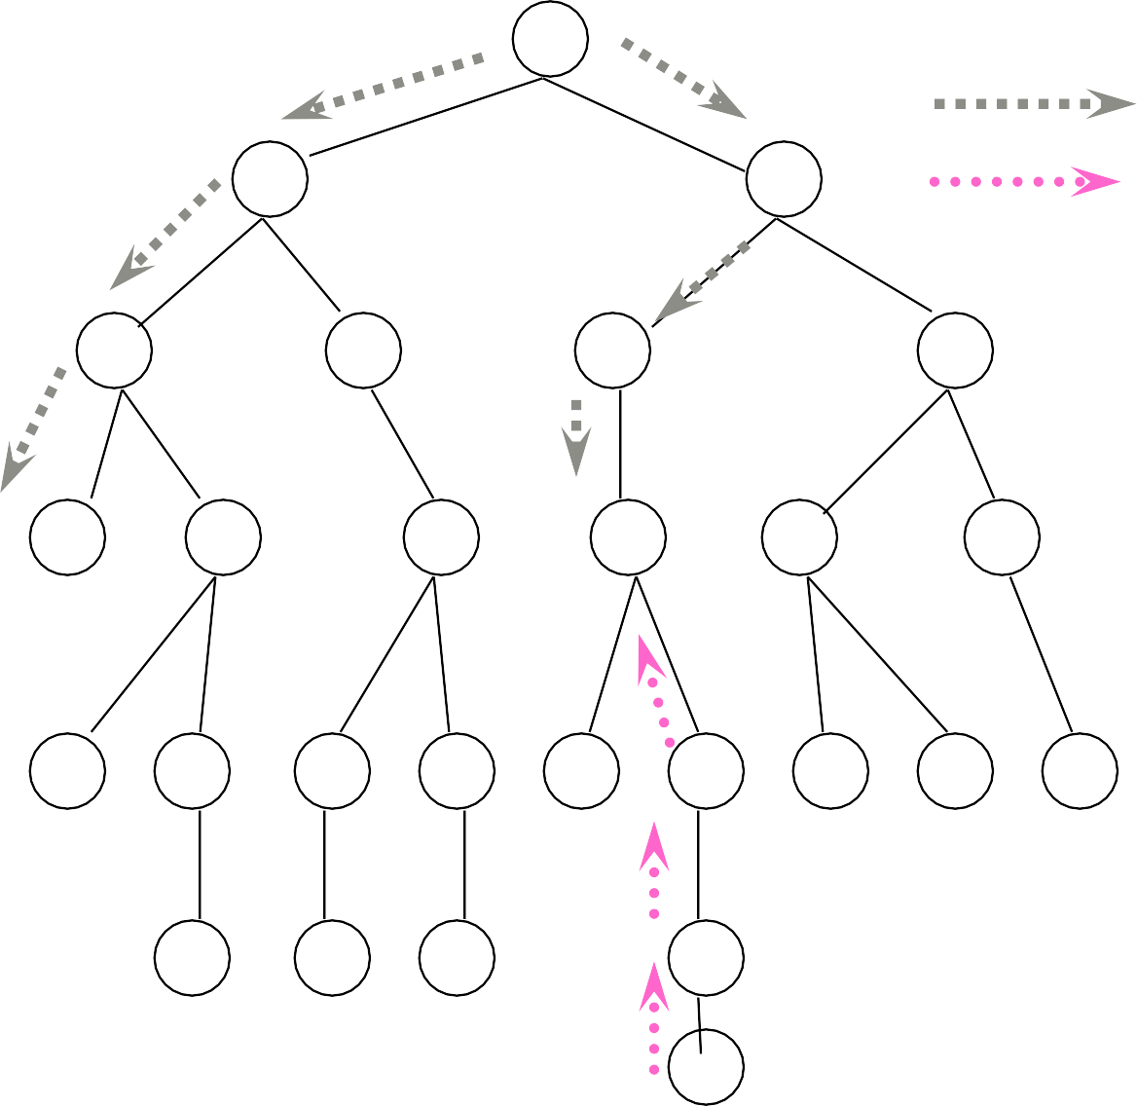
Bi directional Search
S
Forward Backwards
A
D
B
D
A
E
C 11
E
E
B
B
F
D | F | B | F | C | E | A | C | G
14 | G | C | G | 17 | F | 15 | 15 | 13
19
19 17
G 25

Slide 80
Not always optimal, even if both searches are BFS
Check when each node is expanded or selected for expansion
Can be implemented using BFS or iterative deepening (but at least one frontier needs to be kept in memory)
Significant weakness
– Space requirement
Time Complexity is good
Bidirectional
Search
la

Slide 81
Problem: how do we search backwards from goal??
predecessor of node n = all nodes that have n as successor
this may not always be easy to compute!
if several goal states, apply predecessor function to them just as we applied successor (only works well if goals are explicitly known; may be difficult if goals only characterized implicitly).
for bidirectional search to work well, there must be an efficient way to check whether a given node belongs to the other search tree.
select a given search algorithm for each half.
Bidirectional
Search
la

Slide 82
Bidirectional Search
Yes,
2*O(b ^{d/2}) = O(b ^{d/2}) O(b ^{m/2})
Yes
Completeness:
Time complexity:
Space complexity:
Optimality:
To avoid one by one comparison, we need a hash table of size O(b ^{m/2})
If hash table is used, the cost of comparison is O(1)

Slide 83
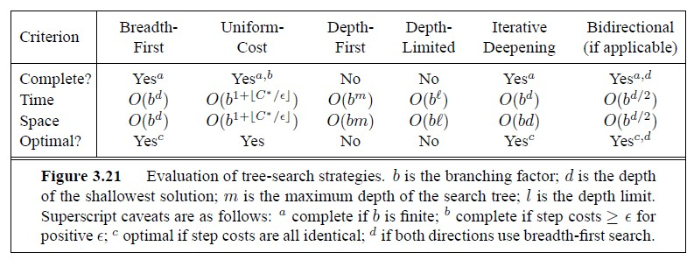
Comparison Uninformed Search Strategies

Slide 84
INFORMED SEARCH
84

Slide 85
Objectives
At the end of this lecture the student should be able to do the following:
Understand what is a heuristic function.
They should be able to design heuristic functions for a given problem.
They should be able to provide that if A* uses an admissible heuristic function, it will produce an optimum solution.
They should learn how to compare two heuristic functions.

Slide 86
Informed Search
We have seen that uninformed
search methods that systematically explore the
state space and find the goals.
– Inefficient in most cases.
Informed Search methods use problem specific knowledge, are more
efficient.
Informed Search method tries to improve problem solving efficiency by using
problem specific knowledge.

Slide 87
Continue…
A search strategy which searches the most promising branches of the state-space first can:
find a solution more quickly,
find solutions even when there is limited time available,
often find a better solution, since more profitable parts of the state- space can be examined, while ignoring the unprofitable parts.
A search strategy which is better than another at identifying the most promising branches of a search-space is said to be more informed.

Slide 88
Continue…
The general approach we consider is called best-first search. Best- first search is an instance of the general TREE-SEARCH or GRAPH- SEARCH algorithm in which a node is selected for expansion based on an evaluation function, f(n).
The evaluation function is construed as a cost estimate, so the node with the lowest evaluation is expanded first.
The implementation of best-first graph search is identical to that for uniform-cost search (previous topic), except for the use of f instead of g to order the priority queue.

Slide 89

Heuristics
Heuristic is a rule of thumb.
“Heuristics are criteria, methods or principles for deciding which among several alternative courses of action promises to be the most effective in
order to achieve some goals”,
Judea Pearl.
Can use heuristics to identify the most promising search path.

Slide 90
Heuristic Function
A heuristic function at a node n is an estimate of the optimum cost from the current node to a goal. Denoted by h(n).
h(n)=estimated cost of the cheapest path from node n to a goal node.
Example
Want to find the path from Vijayawada to Hyderabad
Heuristic for Hyderabad may be straight line distance between Vijayawada and Hyderabad.
h(Vijayawada)=Euclidian distance(Vijayawada, Hyderabad)

Slide 91
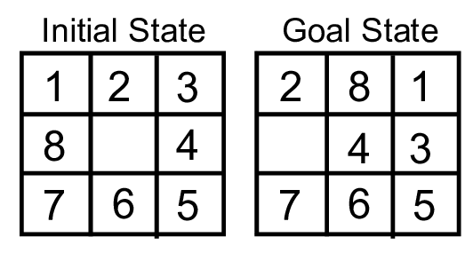
Heuristics Example
8-Puzzle: Number of tiles out of place
h(n)=5 (1,2,3,4,8 are not in correct location)

Slide 92
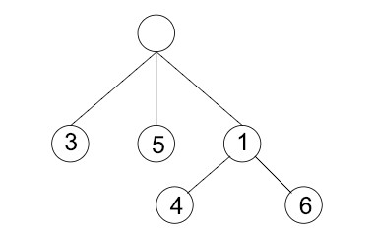
Best First Search
The generic best-first search algorithm selects a node for expansion according to an evaluation function.
It is a generalization of breadth first search.
Priority queue of nodes to be explored.
Cost function f(n) to applied to each node.
Always choose the node from the fringe that has lowest f(n) value.

Slide 93
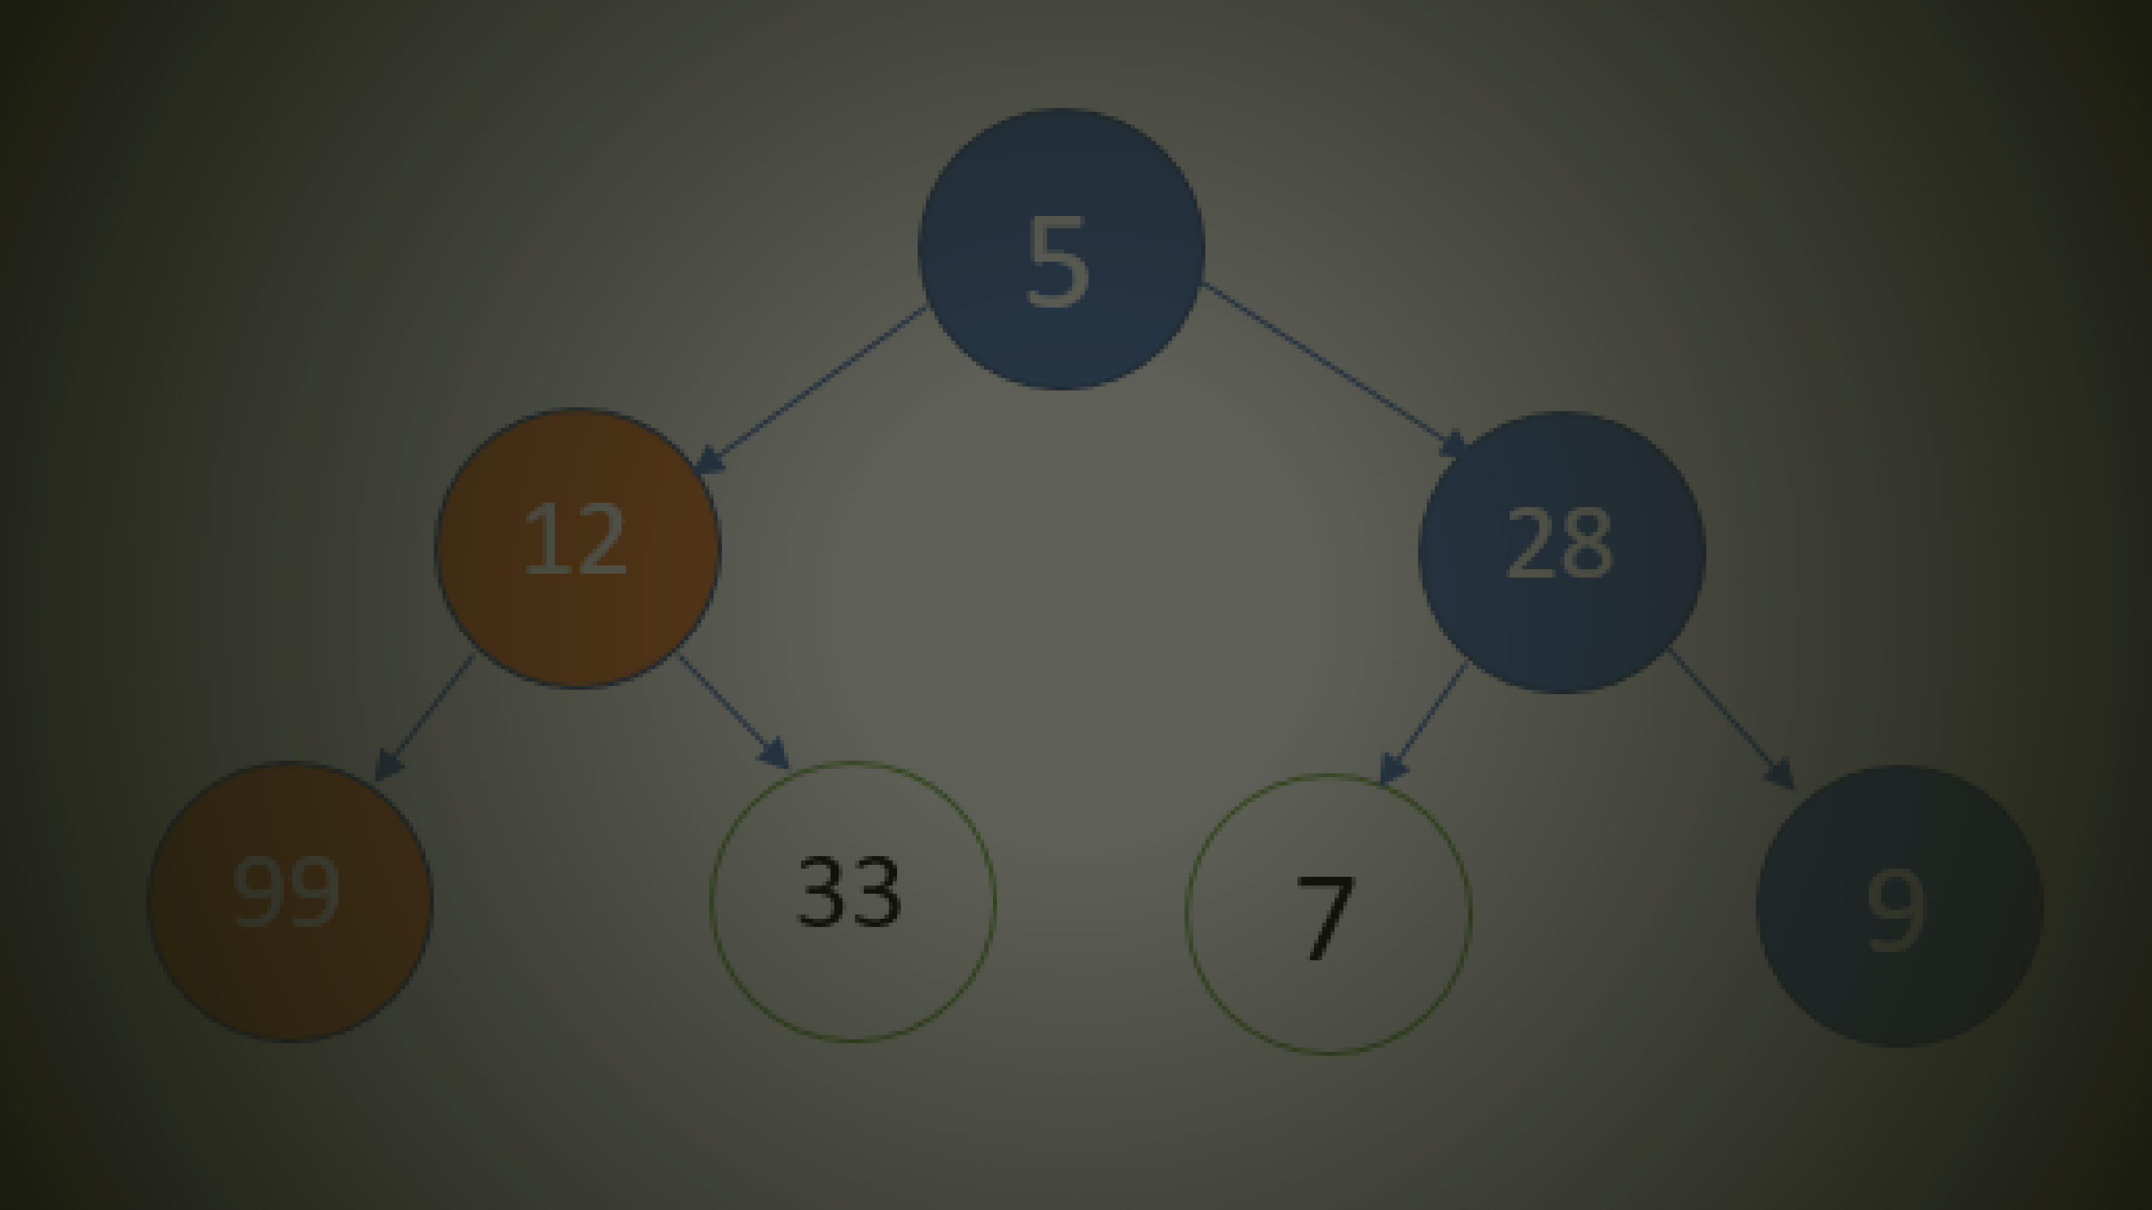
Greedy Search
Expand node with the smallest estimated cost to reach the goal.
Use heuristic function f(n)=h(n)
This algorithm is not optimal
Not complete

Slide 94
Continue..
Greedy best-first search tries to expand the node that is closest to the goal, on the grounds that this is likely to lead to a solution quickly
Thus, the evaluation function is f(n) = h(n)
E.g. in minimizing road distances a heuristic lower bound for distances of cities is their straight-line distance
Greedy search ignores the cost of the path that has already been traversed to reach n
Therefore, the solution given is not necessarily optimal
If repeating states are not detected, greedy best-first search may oscillate forever between two promising states

Slide 95
Continue..
Because greedy best-first search can start down an infinite path and never return to try other possibilities, it is incomplete
Because of its greediness the search makes choices that can lead to a dead end; then one backs up in the search tree to the deepest unexpanded node
Greedy best-first search resembles depth-first search in the way it prefers to follow a single path all the way to the goal, but will back up when it hits a dead end
The worst-case time and space complexity is O(b^{m})
The quality of the heuristic function determines the practical usability of greedy search

Slide 96
Continue…
Start
75
A
State | Heuristic: h(n)
A | 366
B | 374
C | 329
D | 244
E | 253
F | 178
G | 193
H | 98
I | 0
118
140
B
C
111
D
E
80
99
G
F
97
H
101
211
I
Goal
f(n) = h (n) = straight-line distance heuristic

Slide 97
Continue…
Start
75
State | Heuristic: h(n)
A | 366
B | 374
C | 329
D | 244
E | 253
F | 178
G | 193
H | 98
I | 0
A
118
140
B
C
111
D
E
80
99
G
F
97
H
101
211
I
f(n) = h (n) = straight-line distance heuristic
Goal

Slide 98
Continue…
Start
75
State | Heuristic: h(n)
A | 366
B | 374
C | 329
D | 244
E | 253
F | 178
G | 193
H | 98
I | 0
A
118
140
B
C
111
D
E
80
99
G
F
97
H
101
211
I
Goal
f(n) = h (n) = straight-line distance heuristic
Problem Solving Agent|Amar Jukuntla
98

Slide 99
Continue..
Start
75
State | Heuristic: h(n)
A | 366
B | 374
C | 329
D | 244
E | 253
F | 178
G | 193
H | 98
I | 0
A
118
140
B
C
111
D
E
80
99
G
F
97
H
101
211
I
f(n) = h (n) = straight-line distance heuristic
Goal
Problem Solving Agent|Amar Jukuntla
99

Slide 100
Continue..
Start
75
State | Heuristic: h(n)
A | 366
B | 374
C | 329
D | 244
E | 253
F | 178
G | 193
H | 98
I | 0
A
118
140
B
C
111
D
E
80
99
G
F
97
H
101
211
I
f(n) = h (n) = straight-line distance heuristic
Goal
Problem Solving Agent|Amar Jukuntla
100

Slide 101
Continue…
Start
75
State | Heuristic: h(n)
A | 366
B | 374
C | 329
D | 244
E | 253
F | 178
G | 193
H | 98
I | 0
A
118
140
B
C
111
D
E
80
99
G
F
97
H
101
211
I
f(n) = h (n) = straight-line distance heuristic
Goal
Problem Solving Agent|Amar Jukuntla
101

Slide 102
Continue…
Start
75
State | Heuristic: h(n)
A | 366
B | 374
C | 329
D | 244
E | 253
F | 178
G | 193
H | 98
I | 0
A
118
140
B
C
111
D
E
80
99
G
F
97
H
101
211
I
f(n) = h (n) = straight-line distance heuristic
Goal
Problem Solving Agent|Amar Jukuntla
102

Slide 103
Continue…
Start
75
State | Heuristic: h(n)
A | 366
B | 374
C | 329
D | 244
E | 253
F | 178
G | 193
H | 98
I | 0
A
118
140
B
C
111
D
E
80
99
G
F
97
H
101
211
I
f(n) = h (n) = straight-line distance heuristic
Goal
Problem Solving Agent|Amar Jukuntla
103

Slide 104
Continue…
Start
75
State | Heuristic: h(n)
A | 366
B | 374
C | 329
D | 244
E | 253
F | 178
G | 193
H | 98
I | 0
A
118
140
B
C
111
D
E
80
99
G
F
97
H
101
211
I
f(n) = h (n) = straight-line distance heuristic
Goal
Problem Solving Agent|Amar Jukuntla
104

Slide 105
Continue…
Start
75
State | Heuristic: h(n)
A | 366
B | 374
C | 329
D | 244
E | 253
F | 178
G | 193
H | 98
I | 0
A
118
140
B
C
111
D
E
80
99
G
F
97
H
101
211
I
f(n) = h (n) = straight-line distance heuristic
Goal
Problem Solving Agent|Amar Jukuntla
105

Slide 106
Continue…
Start
75
State | Heuristic: h(n)
A | 366
B | 374
C | 329
D | 244
E | 253
F | 178
G | 193
H | 98
I | 0
A
118
140
B
C
111
D
E
80
99
G
F
97
H
101
211
I
f(n) = h (n) = straight-line distance heuristic
Goal

Slide 107
Greedy Search: Tree Search
Start
A

Slide 108
Greedy Search: Tree Search
Start
75
A
118
[329]
140
[374]
B
C
[253]
E

Slide 109
Greedy Search: Tree Search
Start
75
A
118
[329]
140
[374]
B
C
[253]
E
80
99
[193]
[178]
G
F
[366]
A

Slide 110
Greedy Search: Tree Search
Start
75
A
118
[329]
140
[374]
B
C
[253]
E
80
99
[193]
[178]
G
F
[366]
A
211
[253]
I
[0]
E
Goal

Slide 111
Greedy Search: Tree Search
Start
75
A
118
[329]
140
[374]
B
C
[253]
E
80
99
[193]
[178]
G
F
[366]
A
211
[253]
I
[0]
E
Path cost(A-E-F-I) = 253 + 178 + 0 = 431
_{dist(A-E-F-}P_{I}ro₎bl₌em ₁So₄lvi₀ng ₊Agen₉t|₉Am₊ar J₂uk₁un₁tla₌ ₄₅₀
Goal
111

Slide 112
Greedy Search: Complete ?
Start
75
State | Heuristic: h(n)
A | 366
B | 374
** C | 250
D | 244
E | 253
F | 178
G | 193
H | 98
I | 0
A
118
140
B
C
111
D
E
80
99
G
F
97
H
101
211
I
f(n) = h (n) = straight-line distance heuristic
Goal

Slide 113
Greedy Search: Tree Search
Start
A

Slide 114
Greedy Search: Tree Search
Start
75
A
118
[250]
140
[374]
B
C
[253]
E

Slide 115
Greedy Search: Tree Search
Start
75
A
118
[250]
140
[374]
B
C
111
[244]
[253]
E
D

Slide 116
Greedy Search: Tree Search
Start
75
A
118
[250]
140
[374]
B
C
111
[244]
[253]
E
D
Infinite Branch !
[250]
C

Slide 117
Greedy Search: Tree Search
Start
75
A
118
[250]
140
[374]
B
C
111
[244]
[253]
E
D
Infinite Branch !
[250]
C
[244]
D

Slide 118
Greedy Search: Tree Search
Start
75
A
118
[250]
140
[374]
B
C
111
[244]
[253]
E
D
Infinite Branch !
[250]
C
[244]
D

Slide 119
Continue…
Greedy search is not optimal
Greedy search is incomplete without systematic checking of repeated states.
In the worst case, the Time and Space Complexity of Greedy Search are both O(b^{m} ), Where b is the branching factor and m the maximum path length .

Slide 120
A* SEARCH

Slide 121
A* Search
Greedy Search minimizes a heuristic h(n) which is an estimated cost from a node n to the goal state. Greedy Search is efficient but it is not optimal nor complete.
Uniform Cost Search minimizes the cost g(n) from the initial state to n. UCS is optimal and complete but not efficient.
New Strategy: Combine Greedy Search and UCS to get an
efficient algorithm which is complete and optimal.

Slide 122
Continue…
A* uses a heuristic function which f(n) = g(n) + h(n)
g(n) is the exact cost to reach node n from the initial state.
h(n) is an estimation of the remaining cost to reach the goal.
combines g(n) and h(n):

Slide 123
g(n)
n
h(n)
f(n) = g(n)+h(n)

Slide 124
A* Search
Start
State | Heuristic: h(n)
A | 366
B | 374
C | 329
D | 244
E | 253
F | 178
G | 193
H | 98
I | 0
A
75
118
140
B
C
111
D
E
80
99
G
F
97
H
101
211
I
Goal
f(n) = g(n) + h (n)
_{Problem Solvin}g_{g} (_{Ag}n_{e})_{nt}:_{|A}i_{m}s_{a}t_{r}h_{Ju}e_{ku}e_{nt}x_{la}act cost to reach node n from the initial state.
124

Slide 125
A* Search: Tree Search
A
Start

Slide 126
A* Search: Tree Search
A
Start
118
75
140
E
[393]
B
[449]
[447] C

Slide 127
A* Search: Tree Search
A
Start
118
75
140
[393]
99
[449]
[447] C
E
B
80
[413] G
F
[417]

Slide 128
A* Search: Tree Search
A
Start
118
75
140
[393]
99
[449]
[447] C
E
B
80
[413] G
97
F
[417]
[415]
H

Slide 129
A* Search: Tree Search
A
Start
118
75
140
[393]
99
[449]
[447] C
E
B
80
[413] G
F
[417]
97
[415]
H
101
I [418]
Goal

Slide 130
A* Search: Tree Search
A
Start
118
75
140
[393]
99
[449]
[447] C
E
B
80
[413] G
F
[417]
97
[415]
H
I [450]
101
I [418]
Goal

Slide 131
A* Search: Tree Search
A
Start
118
75
140
[393]
99
[449]
[447] C
E
B
80
[413] G
F
[417]
97
[415]
H
I [450]
101
I [418]
Goal

Slide 132
A* Search: Tree Search
A
Start
118
75
140
[393]
99
[449]
[447] C
E
B
80
[413] G
F
[417]
97
[415]
H
I [450]
101
I [418]
Goal

Slide 133
Continue…
A* generates an optimal solution if h(n) is an admissible heuristic and the search space is a tree:
– h(n) is admissible if it never overestimates the cost to reach the destination node.

Slide 134



f(N) = g(N) + h(N)
with h(N) = number of misplaced tiles
8-Puzzle
4
Cutoff=4
6

Slide 135
8 Puzzle Using Number of Misplaced Tiles
1 2 3
8 4
7 6 5
1st
2 8 3
1 6 4
7 5
0+4=4
goal
2nd 4
2 8 3
1 6 4
7 5
2 8 3
1 4
7 6 5
2 8 3
1 6 4
7 5
5+1=6
6
2 8 3
1 4
7 6 5
2 3
1 8 4
7 6 5
2 8 3
1 4
7 6 5
5
5
6

Slide 136


f(N) = g(N) + h(N)
with h(N) = number of misplaced tiles
8-Puzzle
4
Cutoff=4
4
6
6

Slide 137

f(N) = g(N) + h(N)
with h(N) = number of misplaced tiles
8-Puzzle
4
Cutoff=4
4
5
6
6

Slide 138

f(N) = g(N) + h(N)
with h(N) = number of
8-Puzzle
misplaced tiles
5
4
Cutoff=4
4
5
6
6

Slide 139

f(N) = g(N) + h(N)
with h(N) = number of
8-Puzzle
misplaced tiles
6
5
4
Cutoff=4
4
5
6
6

Slide 140
f(N) = g(N) + h(N)
with h(N) = number of misplaced tiles
8-Puzzle
4
Cutoff=5
6

Slide 141
f(N) = g(N) + h(N)
with h(N) = number of misplaced tiles
8-Puzzle
4
Cutoff=5
4
6
6

Slide 142
f(N) = g(N) + h(N)
with h(N) = number of misplaced tiles
8-Puzzle
4
Cutoff=5
4
5
6
6

Slide 143

f(N) = g(N) + h(N)
with h(N) = number of misplaced tiles
8-Puzzle
4
Cutoff=5
4
5
7
6
6

Slide 144

f(N) = g(N) + h(N)
with h(N) = number of misplaced tiles
8-Puzzle
4
Cutoff=5
5
4
5
7
6
6

Slide 145

f(N) = g(N) + h(N)
with h(N) = number of misplaced tiles
8-Puzzle
4
Cutoff=5
5
5
4
5
7
6
6

Slide 146
f(N) = g(N) + h(N)
with h(N) = number of misplaced tiles
8-Puzzle
4
Cutoff=5
5
5
4
5
7
6
6

Slide 147
AO* SEARCH

Slide 148
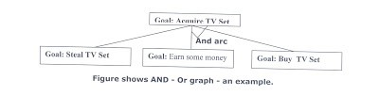
AO* Search
When a problem can be divided into a set of sub problems, where each sub problem can be solved separately and a combination of these will be a solution, AND-OR graphs or AND - OR trees are used for representing the solution.
The decomposition of the problem or problem reduction generates AND arcs. One AND are may point to any number of successor nodes.
All these must be solved so that the arc will rise to many arcs, indicating several possible solutions. Hence the graph is known as AND - OR instead of AND. Figure shows an AND - OR graph.

Slide 149
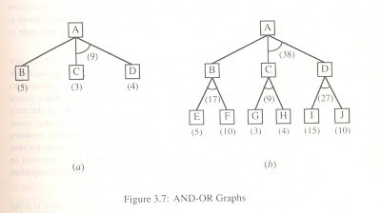
Continue…
An algorithm to find a solution in an AND - OR graph must handle AND area appropriately. A* algorithm can not search AND - OR graphs efficiently.
This can be understand from the give figure

Slide 150
Continue…
Frustration with uninformed search led to the idea of using domain specific knowledge in a search so that one can intelligently explore only the relevant part of the search space that has a good chance of containing the goal state. These new techniques are called informed (heuristic) search strategies.
Even though heuristics improve the performance of informed search algorithms, they are still time consuming especially for large size instances.

Slide 151
AND/OR graphs
Some problems are best represented as achieving subgoals, some of which achieved simultaneously and independently (AND)
Up to now, only dealt with OR options
Possess TV set
Steal TV
Earn Money
Buy TV

Slide 152
Searching AND/OR graphs
A solution in an AND-OR tree is a sub tree whose leafs are included in the goal set
Cost function: sum of costs in AND node f(n) = f(n₁) + f(n₂) + …. + f(n_{k})
How can we extend A* to search AND/OR trees? The AO* algorithm.

Slide 153
AND/OR search
We must examine several nodes simultaneously when choosing the next move
A
A
B
(9)
D
(3)
(5)
C
(4)
38
B
17
F G
(10) (3)
C D
9
27
H I J
(4) (15) (10)
E
(5)

Slide 154
AND/OR Best-First-Search
Traverse the graph (from the initial node) following the best current path.
Pick one of the unexpanded nodes on that path and expand it. Add its successors to the graph and compute f for each of them
Change the expanded node’s f value to reflect its successors. Propagate the change up the graph.
Reconsider the current best solution and repeat until a solution is found

Slide 155
AND/OR Best-First-Search example
A
(5)
1.
2.
A
B
(9)
D
(3)
(5)
C
(4)
3.
A
D
(10)
(4)
(10)
(9)
B
C
(3)
(4)
E
F
(4)

Slide 156
AND/OR Best-First-Search example
4.
A
(12)
(6) C (4)
B
D
(10)
(4)
(10)
G
(5) H
E
F
(7)
(4)

Slide 157
A Longer path may be better
A
B D
A
C
G
H _{E}
J
F
B
C
D
Unsolvable
I
G
H _{E}
J
F
Unsolvable
I

Slide 158
Interacting Sub goals
A
D
C
(5)
E
(2)

Slide 159
AO* algorithm
Let G be a graph with only starting node INIT.
Repeat the followings until INIT is labeled SOLVED or h(INIT) > FUTILITY
Select an unexpanded node from the most promising path from INIT (call it NODE)
Generate successors of NODE. If there are none, set h(NODE)
= FUTILITY (i.e., NODE is unsolvable); otherwise for each SUCCESSOR that is not an ancestor of NODE do the following:
Add SUCCESSSOR to G.
If SUCCESSOR is a terminal node, label it SOLVED and set h(SUCCESSOR) = 0.
If SUCCESSPR is not a terminal node, compute its h
iii.

Slide 160
AO* algorithm (Cont.)
c) Propagate the newly discovered information up the graph by doing the following: let S be set of SOLVED nodes or nodes whose h values have been changed and need to have values propagated back to their parents. Initialize S to Node. Until S is empty repeat the followings:
Remove a node from S and call it CURRENT.
Compute the cost of each of the arcs emerging from CURRENT. Assign minimum cost of its successors as its h.
Mark the best path out of CURRENT by marking the arc that had the minimum cost in step ii
Mark CURRENT as SOLVED if all of the nodes connected to it through new labeled arc have been labeled SOLVED
If CURRENT has been labeled SOLVED or its cost was just changed, propagate its new cost back up through the graph. So add all of the ancestors of CURRENT to S.
iii.

Slide 161
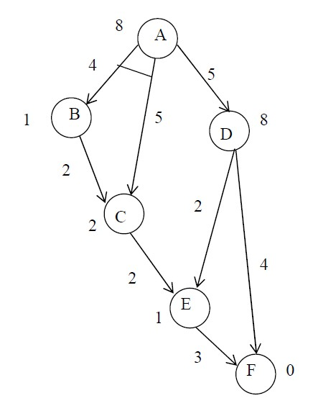
An Example

Slide 162
An Example
(8) _{A}

Slide 163
An Example
[12]
4
B
[13]
5
A
5
(1)
D
(8)
(2) ^{C}

Slide 164
An Example
[15]
4
[13]
5
A
B
5
(4)
D
(8)
2
(2) ^{C}

Slide 165
An Example
[15]
4
[8]
5
A
B
5
(4)
2
(2) ^{C}
D
(3)
2
4
(1) ^{E}
G
(0)

Slide 166
An Example
[15]
4
[9]
5
A
B
5
(4)
D
(4)
2
(2) ^{C}
2
2
4
(3) ^{E}
3
G
(0)

Slide 167
An Example
[15]
4
Solved 5
A
B
5
(4)
D
Solved
2
(2) ^{C}
2
2
4
(3) ^{E}
3
G
Solved
(0)

Slide 168




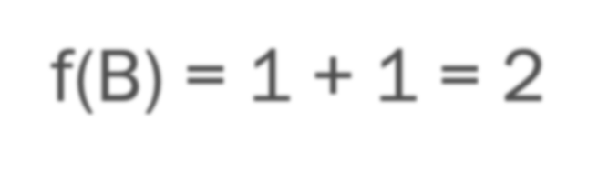
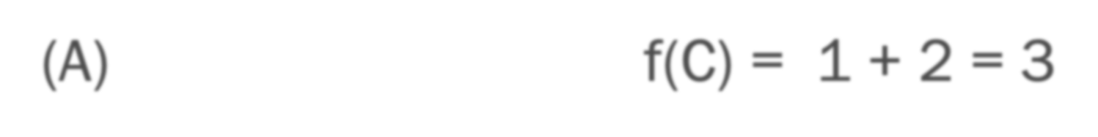
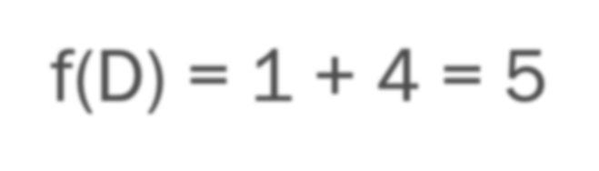
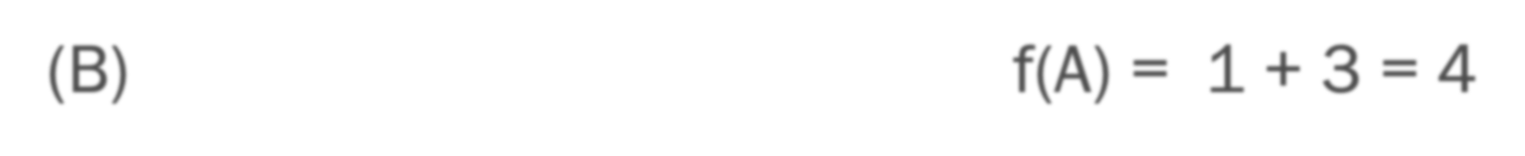
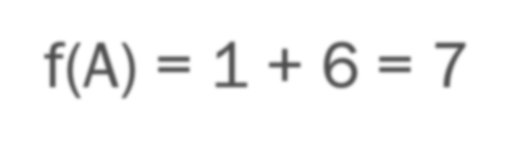
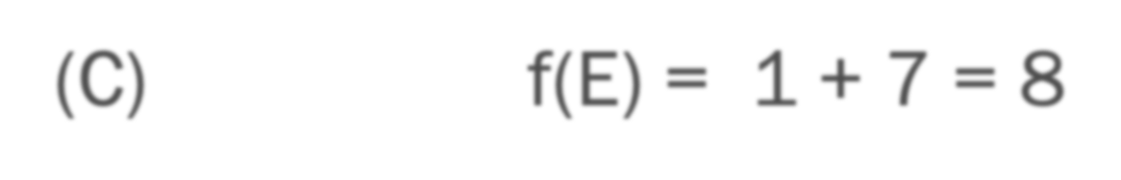
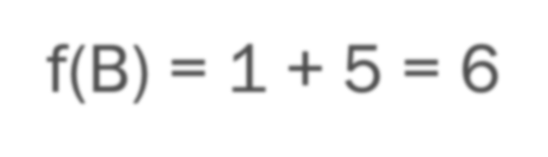
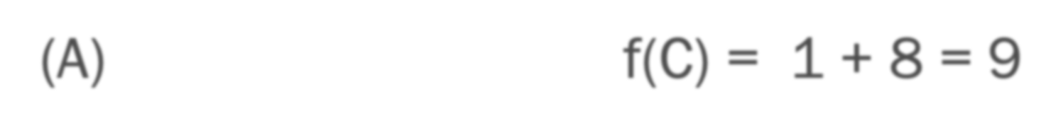
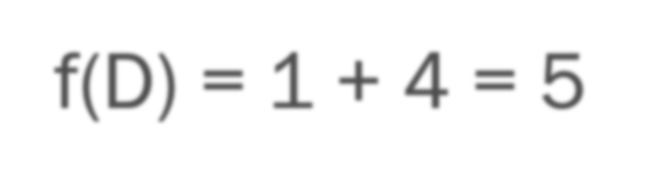
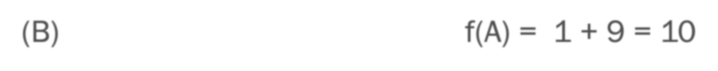
Real Time A*
Considers the cost (> 0) for switching from one branch to another in the search
Example: path finding in real life
11
4
1
2
7
16
F
f(B) = 1 + 1 = 2
f(D) = 1 + 4 = 5
f(B) = 1 + 5 = 6
f(A) = 1 + 6 = 7
f(B) = 1 + 5 = 6
f(D) = 1 + 4 = 5
f(F)=1+11= 12 (D)
D
B
A
(A)
C
E
G
f(C) = 1 + 2 = 3
(B)
f(A) = 1 + 3 = 4
f(C) = 1 + 2 = 3
f(E) = 1 + 7 = 8
f(C) = 1 + 8 = 9
f(A) = 1 + 9 = 10
f(B) = 1 + 10 = 11
(A)
(C)
(A)
(B)

Slide 169
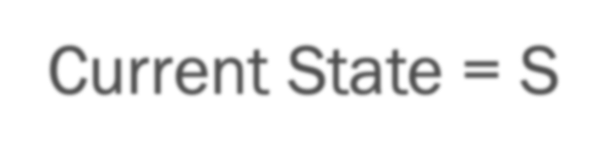

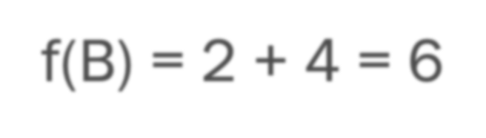

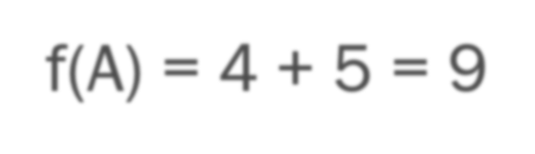
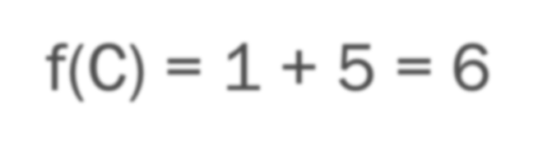
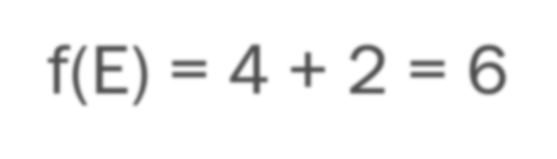

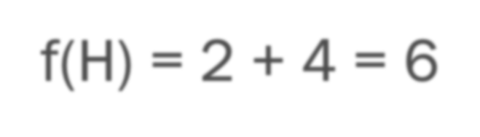

Another Example
Current State = S f(A) = 3 + 5 = 8
f(B) = 2 + 4 = 6
S
3
(5) _{A} ⁴ _{B} (4)
2
4
C E
Current State = B f(S) = 2 + 8 = 10
f(A) = 4 + 5 = 9
f(C) = 1 + 5 = 6
f(E) = 4 + 2 = 6
1
(5)
2
(4) _{H}
(2)
1
F (1)
3
(2) _{D}
2
_{G} (0)
Current State = C f(H) = 2 + 4 = 6
f(B) = 1 + 6 = 7

Slide 170














Another Example
Current State = H f(C) = 2 + 7 = 9
S
3 2
A
Current State = C f(B) = 1 + 6 = 7
f(H) = οο
Current State = B f(S) = 2 + 8 = 10
f(A) = 4 + 5 = 9
f(E) = 4 + 2 = 6
f(C) = οο
4
1
(5)
B
(4)
4
_{E} (2)
1
F (1)
(5) C
2
3
(4) _{H}
(2) _{D}
2
_{G} (0)
Current State = E f(B) = 4 + 9 = 13
f(D) = 3 + 2 = 5
f(F) = 1 + 1 = 2

Slide 171













Another Example
Current State = F f(E) = 1 + 5 = 6
S
3
(5) _{A} ⁴ _{B} (4)
_{E} (2)
2
Current State = E f(D) = 3 + 2 = 5
f(B) = 4 + 9 = 13
f(F) = οο
Current State = D f(G) = 2 + 0 = 2
f(E) = 3 + 13 = 16
1
4
(5) C
2
1
F (1)
3
(4) _{H}
(2) _{D}
2
_{G} (0)
Visited Nodes =
S, B, C, H, C, B, E, F, E, D, G
Path = S, B, E, D, G

Slide 172
References
Artificial Intelligence: A Modern Approach (2nd Edition) by Stuart Russell and Peter Norvig
Wikipedia articles.
https://www.slideshare.net/chandsek666/ch2-3informed-heuristic-search
Slide Adapted from Doina Precup's articles.
Slide: Adapted from Berkeley CS188 course notes (downloaded Summer 2015)
Some images and slides are used from: 1. CS188 UC Berkeley 2. RN, AIMA

